Slide 1
Decision Trees And Ensemble Methods
C5.0 and Random Forest Algorithms

Slide 2







Team Matzinger
Selena Halabi, Kewei Ye, Jordan Smiley, Lexi Wittstadt, and our pets
Loki Rebel Rogue Ophelia Anna Bagel Lola

Slide 3
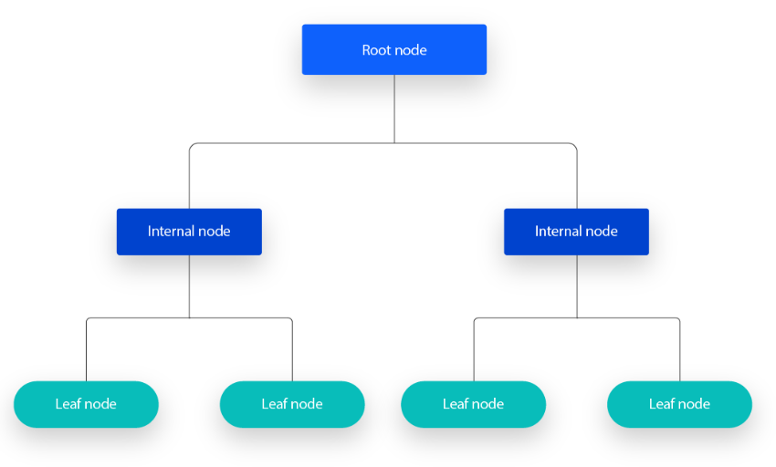
What is a decision tree?
A non-parametric supervised learning algorithm
used for both classification and regression tasks
has hierarchical, tree structure
https://www.ibm.com/topics/decision-trees
Notes:
Non-parametric: analyze data without making assumptions about the data's underlying distribution
A decision tree is a non-parametric supervised learning algorithm, which is utilized for both classification and regression tasks. It has a hierarchical, tree structure, which consists of a root node, branches, internal nodes and leaf nodes.

Slide 4
Terminologies
Root Nodes: represents the original choice or feature from which the tree branches; the highest node
Internal (Decision) Nodes: node whose choices are determined by the values of particular attributes; branches on these nodes that go to other nodes
Leaf (Terminal) Nodes: choices or forecasts are decided upon; no more branches off these
Branch (Edge): Links between nodes that show how decisions are made in response to particular circumstances.
https://www.ibm.com/topics/decision-trees
Notes:
As you can see from the diagram below, a decision tree starts with a root node, which does not have any incoming branches. The outgoing branches from the root node then feed into the internal nodes, also known as decision nodes. Based on the available features, both node types conduct evaluations to form homogenous subsets, which are denoted by leaf nodes, or terminal nodes. The leaf nodes represent all the possible outcomes within the dataset

Slide 5
How is a decision tree formed?
A decision tree recursively partitions the data based on the values of different attributes.
The algorithm selects the best attribute to split the data at each internal node, based on certain criteria
Process continues until a stopping criterion is reached, such as reaching a maximum depth or having a minimum number of instances in a leaf node
Key Assumptions
Binary splits: each node divides the data into two subsets based on a single feature or condition
Recursive partitioning: each node can be divided into child nodes until stopping criterion met
Feature independence
Homogeneity: assumes homogeneous subgroups in each node
Top-down greedy approach: each split is chosen to maximize information gain or minimize impurity at the current node
Notes:
A decision tree employs a divide and conquer strategy by conducting a greedy search to identify optimal split points within a tree
process of splitting is then repeated in a top-down, recursive manner until all, or the majority of records have been classified under specific class labels
Extra info:
Whether or not all data points are classified as homogenous sets is largely dependent on the complexity of the decision tree. Smaller trees are more easily able to attain pure leaf nodes—i.e. data points in a single class. However, as a tree grows in size, it becomes increasingly difficult to maintain this purity, and it usually results in too little data falling within a given subtree. When this occurs, it is known as data fragmentation, and it can often lead to overfitting.
To reduce complexity and prevent overfitting, pruning is usually employed; this is a process, which removes branches that split on features with low importance. The model’s fit can then be evaluated through the process of cross-validation.
Another way that decision trees can maintain their accuracy is by forming an ensemble via a random forest algorithm; this classifier predicts more accurate results, particularly when the individual trees are uncorrelated with each other.

Slide 6
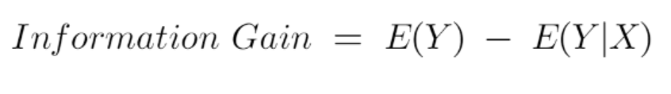
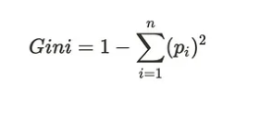
Attribute Selection Measures
Information Gain
Entropy: measure of disorder/uncertainty in dataset
2. Gini Index: metric to measure how often a randomly chosen element would be
incorrectly identified; measure of inequality/impurity of a distribution
Ranges from 0 to 0.5
0 = pure set (all instances belong to the same class)
0.5 = maximally impure set (instances are evenly distributed across classes)
Notes:
It is just entropy of the full dataset – entropy of the dataset given some feature. (ranges between 0 and 1)
If all samples in data set, S, belong to one class, then entropy will equal zero. If half of the samples are classified as one class and the other half are in another class, entropy will be at its highest at 1.

Slide 7
Why use a decision tree?
Decision trees are widely used in machine learning because of their
High interpretability and versatility
Proficiency with both numerical and categorical data
Simple visualization

Slide 8
C5. 0 Algorithm
Entropy and Information Gain
Splits a certain attribute to measure entropy reduction
Subtacts the entropy of the split from the original entropy
Makes it more organized bases on homogeneous grouping
Builds a rule set (decision tree) to divide the subsamples determined by the initial split, then repeated
Optimizes information gain
Predicts categorical outcomes based on the input features
Chooses the best feature at each node
Size and quality of the subgroups to determine the best splits
Pruning mechanism to prevent overfit
Removes splits that are not useful
Notes:
This method is built around reduction in entropy and information gain
The measure of entropy is determined by subtracting the entropy of the split from the original entropy. The largest reduction is the selected split, which makes more organized, homogenous groups
The goal is to build a rule set that divides based on the entropy adn then repeats to optimize information gain
This results in categorical outcomes based on the input features and the size and quality determines the best splits
Pruning is used to prevent overfitting by removing splits that do not contribute to the information gain

Slide 9
Example of C5.0 -Categorizing our pets!
Overall Entropy of our pets - chaotic (there are a lot of them) let says we’ll quantify by the number of pictures in each category
What method of dividing will lower the entropy the most? Color? Ear Shape? Size? Presence of whiskers? Presence of a toy?
Calculate the entropy of each option….
Choose the one that lowers the entropy
Black = Cat
Brown = Dogs
Gray = ???
Notes:
Step by step
Determine overall entropy - baseline measurement of impurity
Calculate the entropy of each partition that results from splitting the data set
Calculate the information gain for each attribute. Subtract the average entropy from each division from the baseline measurement to determine entropy reduction from each possible division
Select feature that yields the most information gain
Repeat!

Slide 10
Example of C5.0 - Categorizing our pets !
Overall Entropy of our pets - chaotic (there are a lot of them) let says we’ll quantify by the number of pictures in each category
What method of dividing will lower the entropy the most? Color? Ear Shape? Size? Presence of whiskers? Presence of a toy?
Calculate the entropy of each option….
Choose the one that lowers the entropy
No Whiskers = Dogs
Whiskers = Cat

Slide 11

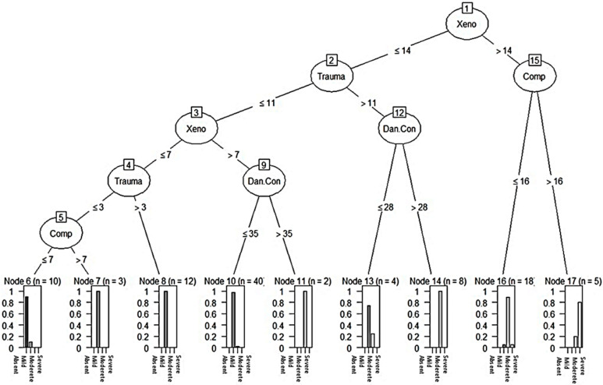
C5.0 For Real
Delgado-Gallegos, J. L., Avilés-Rodriguez, G., Padilla-Rivas, G. R., De Los Ángeles Cosío-León, M., Franco-Villareal, H., Nieto-Hipólito, J. I., de Dios Sánchez López, J., Zuñiga-Violante, E., Islas, J. F., & Romo-Cardenas, G. S. (2023). Application of C5.0 Algorithm for the Assessment of Perceived Stress in Healthcare Professionals Attending COVID-19. Brain sciences, 13(3), 513. https://doi.org/10.3390/brainsci13030513
Factors used to classify healthcare professionals:
Fear of contamination, social economical, xenophobia, traumatic stress, compulsive stress
Notes:
https://pmc.ncbi.nlm.nih.gov/articles/PMC10046351/
Used to categorize the perceived level of stress (as it can be a detonating factor for mental illness)
Stress level was the defined target variable
Profession, work area, and cumulative stress scales as predictors
C5.0 algorithm was used to study datasets to develop an explainable classification diagram to better understand mental health in pandemic scenarios.
Locate the combination of factors that are needed to correctly classify healthcare professionals by
Fear of contamination
Socialeconomial
Xenophobia
Traumatic stress
Compulsive stress

Slide 12
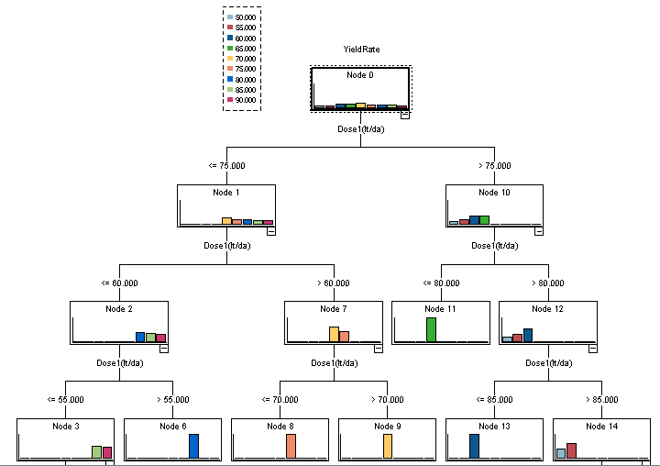
C5.0 Strengths & Weaknesses
Strengths:
Scalable and efficient
Handles both continuous and categorical characteristics
Robust pruning mechanism
Capable of handling noisy data
Interpretable and intuitive
Weaknesses:
Strongly connected qualities may cause the C5 algorithm to perform less effectively as it may place too much emphasis on one feature at the expense of others.
Careful parameter selection is necessary
Sensitive to missing values
Complex nonlinear interactions may not be a good fit for decision trees.
Notes:
https://www.researchgate.net/figure/Structure-of-decision-tree-of-the-C50-algorithm_fig6_327942169
Scalable and efficient: The C5 method has a high processing efficiency and performs well with big datasets.
Capable of handling noisy data: The C5 algorithm can function effectively in real-world situations and is comparatively robust to noisy data.
Handles both continuous and categorical characteristics: The versatility of the C5 method extends to a variety of data types, since it is capable of handling both continuous and categorical (nominal) properties.
Robust pruning mechanism: To avoid overfitting and enhance generalization, the C5 method makes use of a strong pruning mechanism.
Interpretable and intuitive: The C5 method is appropriate for situations where interpretability is crucial as decision trees are often simple to comprehend and interpret.
Strongly connected qualities may cause the C5 algorithm to perform less effectively as it may place too much emphasis on one feature at the expense of others.
Careful parameter selection is necessary: The C5 method has a number of parameters that must be chosen carefully in order to maximize performance, such as the significance level for winnowing and the confidence factor for pruning.
Sensitive to missing values: The performance of the C5 method may be impacted by missing values in the data, and handling them successfully may require the use of certain strategies.
Complex nonlinear interactions may not be a good fit for decision trees: Decision trees aren’t designed to be good models for intricate nonlinear relationships between variables.

Slide 13
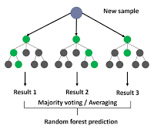
Random Forest - Decision tree algorithm
Ensemble learning technique
Utilizes bagging/bootstrap sampling
Merges the results of multiple decision trees into one result
Can handle both continuous and categorical data
How it works:
Select a random subset of the data set (size K)
Make a decision tree from this subset of data
Take a new subset of data (with replacement) and repeat, again and again!
For new data, compare the output of the decision trees/aggregate the data
The most common result wins!
Yehoshua, R. Random Forests. Medium.com.

Slide 14
Random Forest Example Using Our Pets!
Let’s say we are trying to determine if a pet will have an outgoing or shy personality.
Let’s say the seven pets here are our “training set”. We know their personalities already – it’s a supervised training model
How can we do this with random forest?

Slide 15
Random Forest Example Using Our Pets!
First, we pick a subset of the seven pets randomly. Let’s say we pick 4, and these are the ones chosen:

Slide 16
Random Forest Example Using Our Pets!
Now we create a decision tree!
The model will create nodes using random characteristics.
black/white/gray
color
The outcome is that two groups are classified as outgoing, and one group is shy.
outgoing
sitting
standing
shy
outgoing

Slide 17
Random Forest Example Using Our Pets!
Now we pick a different subset of pets. We are allowed to repeat!

Slide 18
Random Forest Example Using Our Pets!
Now we create a decision tree (again)!
The model will create nodes using random characteristics.
cat
dog
The outcome is that two groups are classified as outgoing, and two groups are shy.
small
large
small
large
shy
outgoing
shy
outgoing

Slide 19

Random Forest Example Using Our Pets!
We do this a lot of times, to make a “forest” of trees.
For our simple example, however, let’s say our whole model is these two trees.
Now we take new data points and run it through this collection.
Let’s use my sister’s cat Alasia!

Slide 20
Random Forest Example Using Our Pets!
black/white/gray
color
cat
dog
outgoing
small
large
small
large
sitting
standing
outgoing
shy
shy
outgoing
outgoing
shy
Alasia is classified as outgoing! (This is definitely true, so our model is good!)

Slide 21

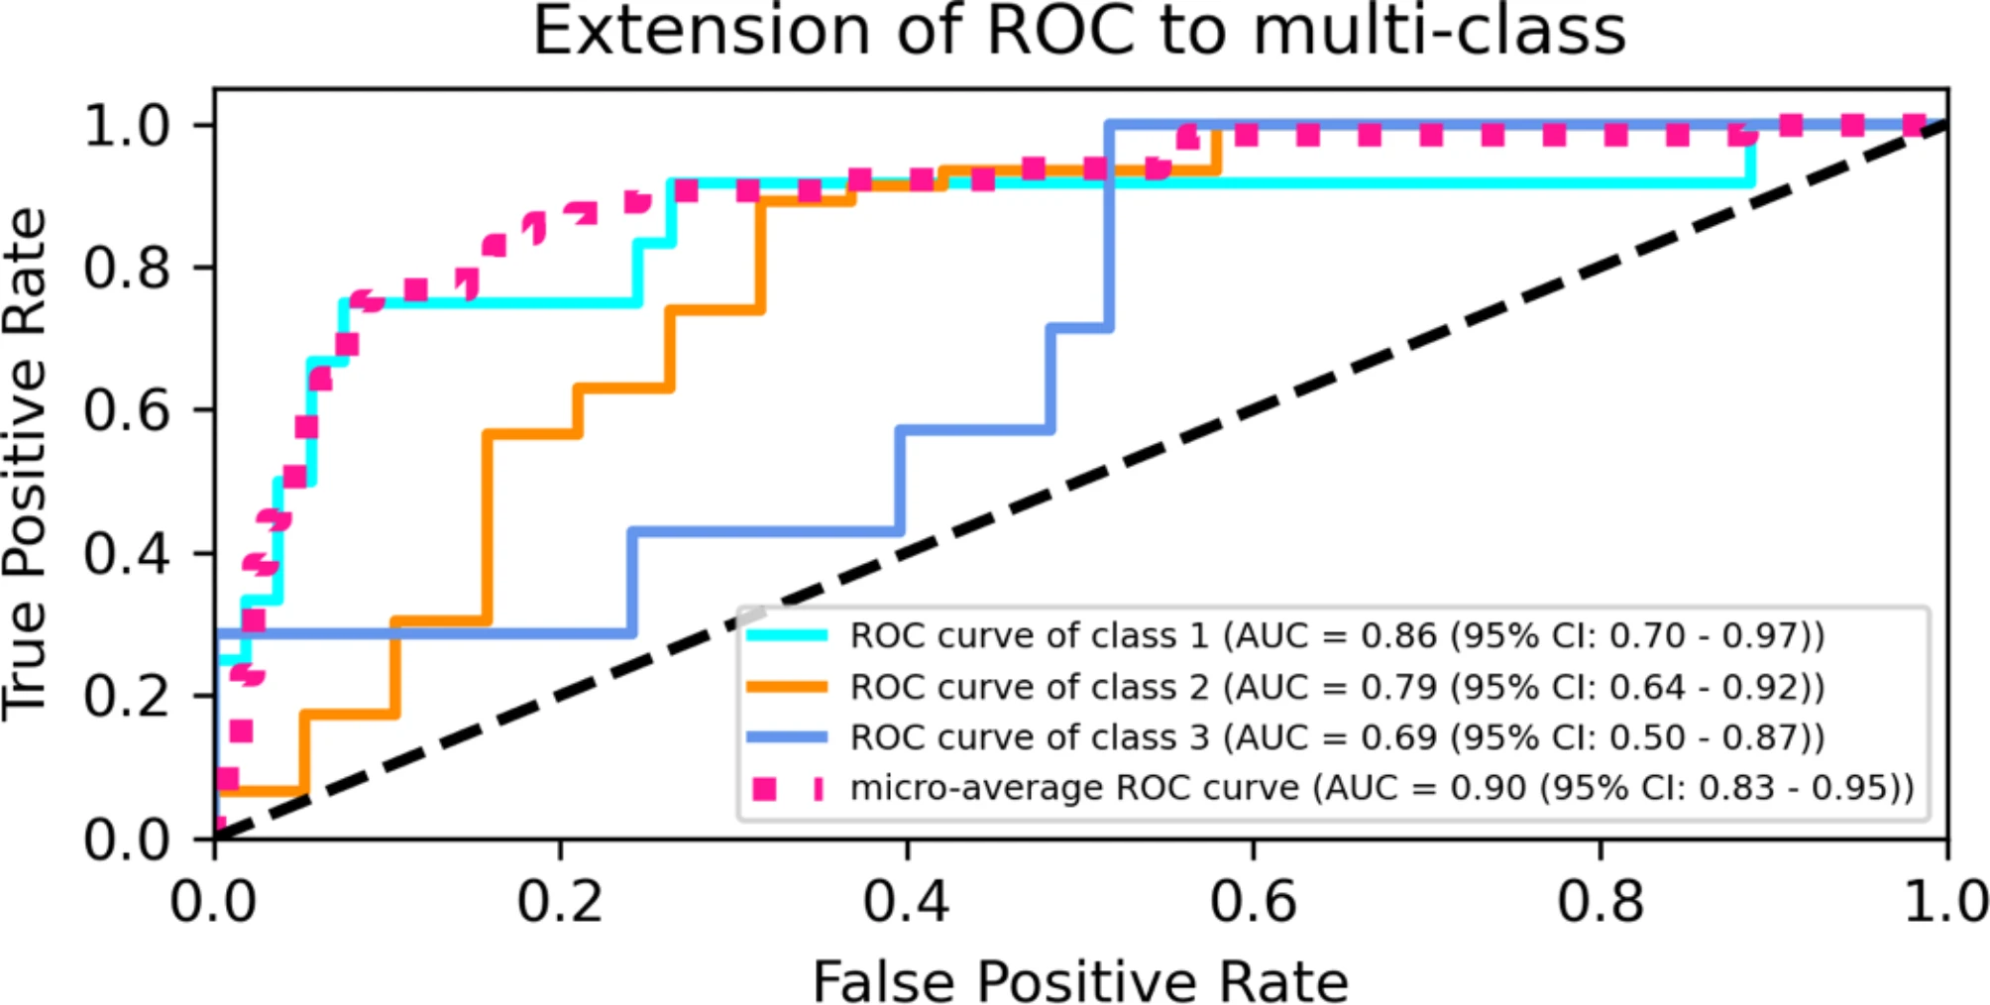
Random Forest - Real World Example
Class 1: COVID-19 positive
Class 2: Mycoplasma pneumoniae positive
Class 3: co-infected

Slide 22
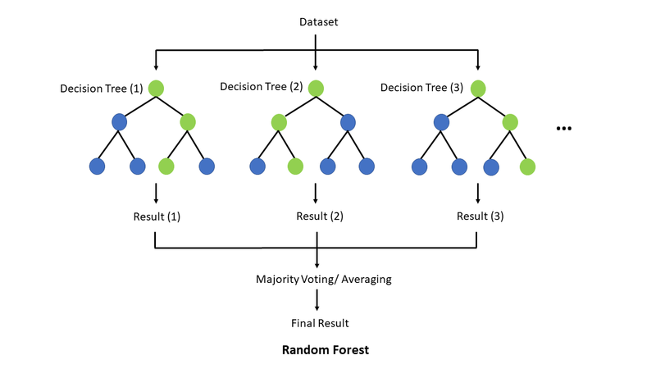
Random Forest Strengths & Weaknesses
Strengths:
High accuracy
Robustness to noise
Non-parametric nature
Estimating feature importance
Handles missing data and outliers
Handles both numerical and categorical data
Generally avoids overfitting (but it can happen)
Weaknesses:
Computational Complexity
Memory usage
Prediction time
Lack of interpretability
Notes:
https://interactivechaos.com/en/wiki/random-forest
High Accuracy: Using several decision trees, each trained on a distinct subset of the data, Random Forest aggregates their predictions. Random Forest lessens the variation associated with individual trees, resulting in predictions that are more accurate, by averaging (for regression) or voting (for classification) the predictions of these trees. When using an ensemble approach instead of a single decision tree model, accuracy is typically higher.
Robustness to Noise: As Random Forest combines the forecasts of several decision trees, it is resilient to noisy data. Because noisy data points are unlikely to alter the forecasts of every tree in the forest, they have a lower chance of affecting the overall performance of the model. Random Forest works well with datasets that contain outliers or intrinsic noise because of its robustness.
Non-Parametric Nature: Random Forest approach is non-parametric, which means it does not assume anything about the distribution of the data at the root level or the correlation between the target variable and characteristics. Due to its adaptability, Random Forest may be applied to a variety of datasets and problem areas and can identify intricate patterns in the data without imposing rigid limitations.
Estimating Feature Importance: Random Forest calculates a feature's importance by taking into account the relative contributions of each feature to the overall variance (for regression) or impurity (for classification) reduction of all the trees in the forest. Features are considered more significant when they regularly result in a larger reduction of impurities or variance. This data can direct feature selection or dimensionality reduction efforts and aid in determining which characteristics are most relevant for prediction.
Handles Missing Data and Outliers: Random Forest does not require the use of data preprocessing methods like imputation or outlier removal in order to handle missing data and outliers. Every decision tree is trained using a random subset of the input, and the technique naturally handles missing values. As outliers are unlikely to affect the forecasts of every tree in the forest, they have less of an effect on the performance of the model as a whole.
Handles Both Numerical and Categorical Data: Without the use of feature engineering strategies like one-hot encoding, Random Forest is capable of handling a combination of numerical and categorical characteristics. The method can handle both types of data without bias since it automatically chooses random subsets of features for each decision tree during training.
Disadvantages
Computational Complexity: Using a large number of trees in the forest or training a Random Forest model on a large dataset can be computationally expensive. Since each tree is trained separately, it takes a lot of computing power to aggregate its predictions. This can lead to greater memory utilization and training times, especially on systems with limited resources.
Memory Usage: Random Forest models have a tendency to use a lot of memory, particularly when working with big datasets or deeply rooted trees. The training data, feature splits, and leaf node predictions must all be stored in each decision tree in the forest. Memory utilization rises with the number of trees or the depth of the trees, which may cause memory limitations on some hardware systems.
Prediction Time: Random Forest models can take longer to make predictions than certain other algorithms, even though they are more effective at training. This is particularly true for large datasets or models with a lot of trees. To get a final forecast, each observation must navigate through several decision trees in the forest. This might lengthen the prediction time, especially for real-time or latency-sensitive applications.
Lack of Interpretability: As Random Forest models integrate several decision timber, it is able to be difficult to understand the logic underlying each prediction, that's why they may be sometimes referred to as 'black-box' models. Although characteristic significance measures can assist pick out the most essential features, it is able to be tough to recognize the tricky relationships between features and the way they have an effect on predictions.
Overfitting: Generally Random Forest is good at avoiding overfitting. However, it can suffer from overfitting when the model captures noise in the training data, leading to poor generalization on new data. The algorithm's ability to fit the training data too closely can result in reduced performance on unseen instances, compromising its predictive accuracy in real-world scenarios.

Slide 23
Key differences
Feature | C5.0 | Random Forest
Ensemble Approach | Usually single decision tree | Ensemble of decision trees
Handling of Missing Data | Sensitive to missing values | Can handle
Overfitting Resistance | Using pruning mechanisms | Aggregation of diverse decision trees
Feature Selection | The most information gain | Random
Interpretability | Interpretable and intuitive | Lack of interpretability
Prediction Time | Relatively shorter | Relatively longer
Notes:
C5.0 is a single decision tree while random forest utilizes an ensemble of decision trees, combining their outputs for predictions, fostering robustness and accuracy.

Slide 24
Thanks!
Do you have any questions?

Slide 25
Resources
GeeksforGeeks, (2023) C5.0 Algorithm of Decision Tree,, https://www.geeksforgeeks.org/c5-0-algorithm-of-decision-tree/
IBM Corporation, (2024), C5.0 node https://www.ibm.com/docs/en/cloud-paks/cp-data/5.0.x?topic=modeling-c50-node
GeeksforGeeks. (2024). Random Forest Algorithm in Machine Learning. https://www.geeksforgeeks.org/random-forest-algorithm-in-machine-learning/
GeeksforGeeks. (2024). GeeksforGeeks. (2024). What are the Advantages and Disadvantages of Random Forest?
https://www.geeksforgeeks.org/what-are-the-advantages-and-disadvantages-of-random-forest/
Delgado-Gallegos, J. L., Avilés-Rodriguez, G., Padilla-Rivas, G. R., De Los Ángeles Cosío-León, M., Franco-Villareal, H., Nieto-Hipólito, J. I., de Dios Sánchez López, J., Zuñiga-Violante, E., Islas, J. F., & Romo-Cardenas, G. S. (2023). Application of C5.0 Algorithm for the Assessment of Perceived Stress in Healthcare Professionals Attending COVID-19. Brain sciences, 13(3), 513. https://doi.org/10.3390/brainsci13030513
IBM, (2024). What is a decision tree? https://www.ibm.com/topics/decision-trees
What is Decision Tree? [A Step-by-Step Guide]
Analytics Vidha, (2024) https://www.analyticsvidhya.com/blog/2021/08/decision-tree-algorithm/#h-decision-tree-assumptions.

